Slide 1

Club Vela Calella

Slide 2


Welcome !!
EurILCA MASTER 2025
XVII TROFEU CALELLA DE PALAFRUGELL MEMORIAL PITUS JIMÉNEZ

Slide 3


EurILCA Master Spain 2025
This is a sustainable event !!!

Slide 5
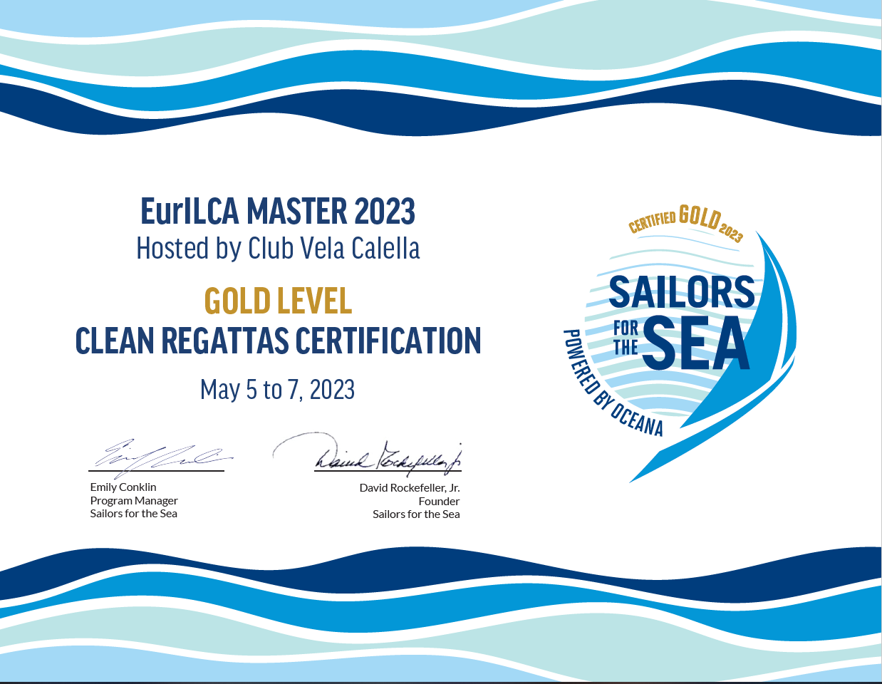

Slide 6


Slide 7
EurILCA MASTER 2025
XVII TROFEU CALELLA DE PALAFRUGELL MEMORIAL PITUS JIMÉNEZ
RACE OFFICE
OPENING HOURS
From 9 am to 6 pm

Slide 8
EurILCA MASTER 2025
XVII TROFEU CALELLA DE PALAFRUGELL MEMORIAL PITUS JIMÉNEZ
REGISTRATION
Only Thursday
From 10 am to 7 pm

Slide 9
EurILCA MASTER 2025
XVII TROFEU CALELLA DE PALAFRUGELL MEMORIAL PITUS JIMÉNEZ
WELCOME PARTY
Thursday, 7 pm
Restaurant Les Voltes

Slide 10
EurILCA MASTER 2025
XVII TROFEU CALELLA DE PALAFRUGELL MEMORIAL PITUS JIMÉNEZ
REGATTA DINER
Saturday, 8 pm @ Hotel Garbí
Sailors : free / Companions: 33€ / Children : 17€

Slide 11


Please recycle !!!
Use the selective collection points !!!
Together, let's protect the environment !!!
EurILCA MASTER 2025
XVII TROFEU CALELLA DE PALAFRUGELL MEMORIAL PITUS JIMÉNEZ

Slide 12
NOTICE:
No bow stickers !!!!
EurILCA MASTER 2025
XVII TROFEU CALELLA DE PALAFRUGELL MEMORIAL PITUS JIMÉNEZ
According to World Sailing sustainability
program policies, no bow stickers will be used.

Slide 13
Trolleys label removal !!!!
EurILCA MASTER 2025
XVII TROFEU CALELLA DE PALAFRUGELL MEMORIAL PITUS JIMÉNEZ
After last day racing, Sailing Club Staff will remove the trolley labels for future events.

Slide 14
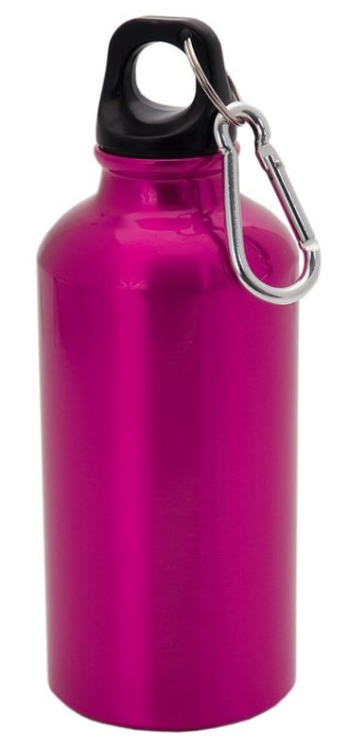
EurILCA MASTER 2025
XVII TROFEU CALELLA DE PALAFRUGELL MEMORIAL PITUS JIMÉNEZ
Use reusable bottles !!!

